Slide 1
Class E Airspace
What it is and how you can operate in it
Notes:
Introduce yourself
Today, we’re going to talk about Class E airspace. This presentation will cover, from a UAS perspective, what Class E airspace is and how you can operate in it.

Slide 2
Objectives:
Understand Class E airspace:
Types E2, E3, and E4
How it’s depicted on charts
Authorization Requirements
Notes:
While this may seem straight forward, how Class E airspace is designated can be particularly confusing for drone pilots (and manned pilots). But, good news!
By the end of this presentation, you will know what the different types are, how they affect your drone operation, how to spot them on an aeronautical chart, and when you’ll need an FAA authorization to operate within them.

Slide 3
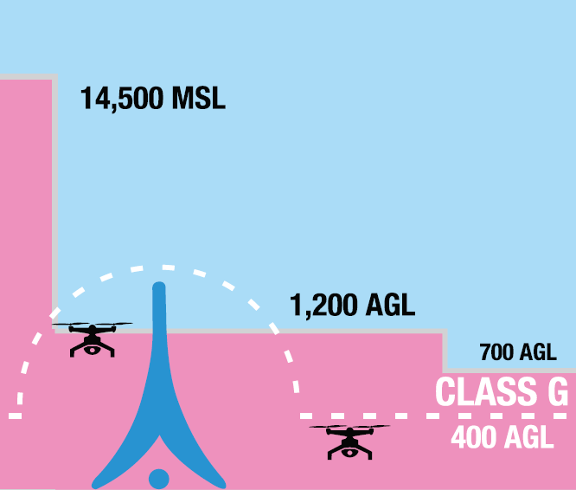
Class Echo Airspace:
Generally begins where Class Golf ends
Typically 700ft or 1,200ft Above Ground Level
Unless associated with an airport surface area
ATC authorization not required for Part 107 operations
CLASS E
Notes:
Class Echo airspace generally begins where Class Golf ends which usually varies between 700ft and 1200ft above ground level, or AGL.
Since this Class Echo airspace is not associated with an airport surface area, Part 107 operators do NOT require an Air Traffic Control authorization prior to flying in this type of Class Echo.
This image represents a profile (or side) view of the Class E airspace. Let’s see how that looks on an FAA aeronautical chart.

Slide 4
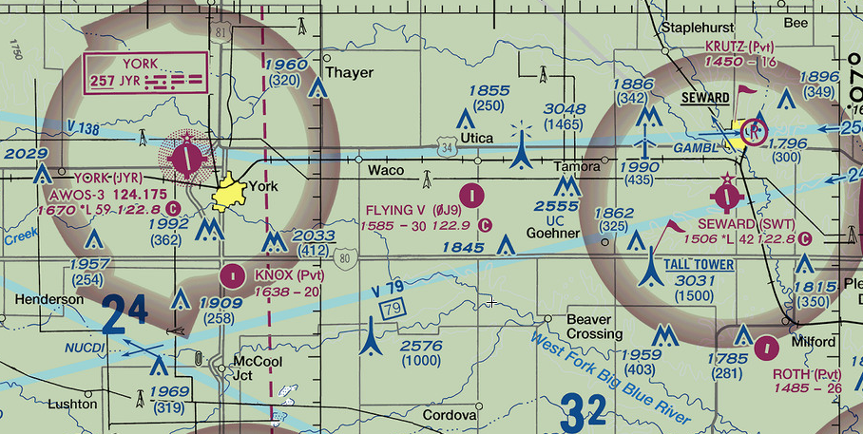
Class E begins at 700’ AGL
Class E begins at 700’ AGL
Class E begins at 1,200’ AGL
Notes:
It’s important to remember that Class Echo airspace begins at 1200ft AGL unless otherwise shown.
When Class Echo begins at 700ft AGL, it is indicated by a magenta shaded ring [CLICK], usually surrounding an airport.
Now, you might be wondering why you need to know about Class Echo airspace that starts at 700 or 1200ft when most drone flights are limited to 400ft.

Slide 5
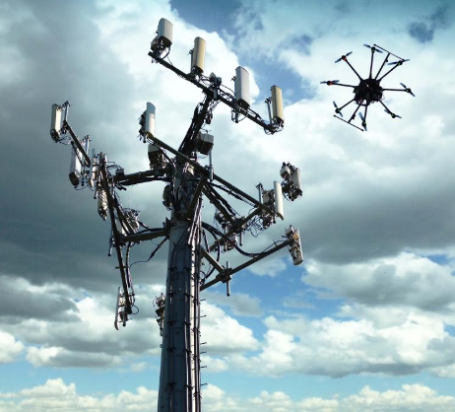
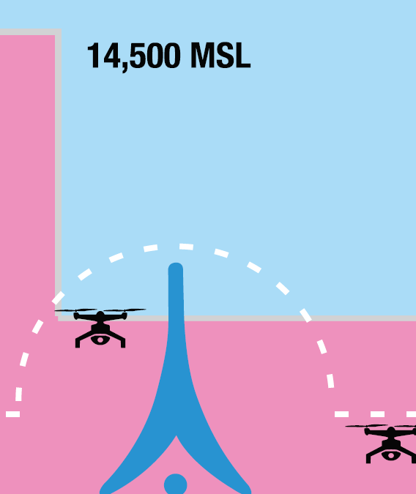
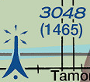
Class E Airspace Operations:
Tower Inspections:
§107.51(b)
Limits maximum altitude to 400ft Above Ground Level
Exceptions:
Is flown within a 400-foot radius of a structure; and
Does not fly higher than 400 feet above the structure's immediate uppermost limit
1,200 AGL
400 AGL
Notes:
The FAA’s small UAS Rule, Part 107. 51(b) allows for drone flights to fly higher than 400ft AGL in certain situations.
If you are operating within a 400ft radius of a structure, you can fly to the structure’s upper most limit, plus an additional 400ft.
This can be beneficial for a variety of UAS missions: for example, inspecting a cell tower.
Consider the example structure shown here, you could fly to a maximum altitude of 1,865ft above ground level as long as you complied with all other parts of the small UAS rule, such as maintaining visual line of sight.
In this example, flying at 1,865 feet means that you are operating in Class Echo airspace. And remember, Class Echo does not require an airspace authorization under Part 107.

Slide 6
Surface Class Echo:
No person may operate a small unmanned aircraft…within the lateral boundaries of the surface area of Class E airspace designated for an airport unless that person has prior authorization from Air Traffic Control (ATC)
(Small UAS Operating Rules) 14 CFR §107.41
Notes:
Let’s take a look at the other type of Class Echo airspace: Surface Class Echo.
This type of airspace causes the most confusion.
The regulations clearly state that operations within the lateral boundaries of the surface area of Class Echo airspace designated for an airport, require an airspace authorization.
So, what is Surface Class Echo airspace and how do you know when it’s designated for an airport?

Slide 7
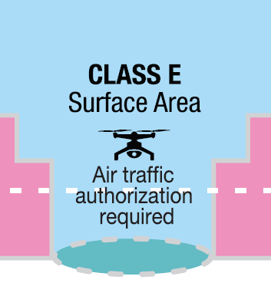
Surface Class E Airspace:
Starts at ground level:
Type E4
Extension to Class D or E surface area
Type E3
Extension to a Class C surface area
Type E2
Surface area for an airport
AUTHORIZATION NEEDED
Notes:
Simply put, it’s Class Echo airspace is that extends down to the surface instead of the common 700ft or 1200ft above ground level.
This category of airspace exists to add additional protection to arriving and departing aircraft. Because of this, certain portions of Surface Class Echo airspace require authorization prior to flight.
We’re going to talk about 3 types of Surface Class Echo airspace: Echo 4, Echo 3, and Echo 2. Of these, only Echo 2 requires an airspace authorization.

Slide 8
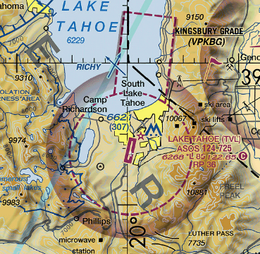
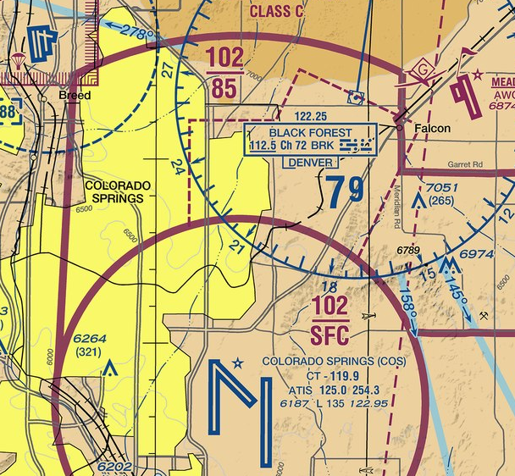
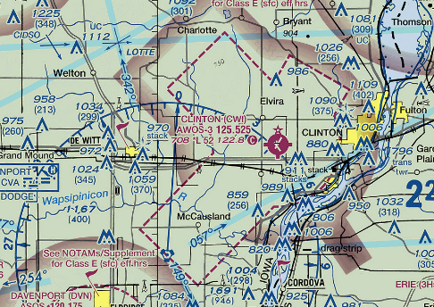
SURFACE ECHO - E4
No ATC Authorization
SURFACE ECHO - E3
No ATC Authorization
SURFACE ECHO - E2
ATC Authorization Needed
Three different types of surface Class E airspace extensions
Notes:
Through the next few slides, I’ll walk you through the different types of Surface Class Echo and how you can identify which type is in your area.
We’re going to start with Class Echo extensions. These exist to allow manned aircraft to make safe approaches to runways in bad weather.
Just remember that while Echo 4 and 3 don’t require ATC authorization, Echo 2, does.

Slide 9
Surface Echo - E4
No ATC authorization needed (Type E4)
Magenta dashed line segregates the airspace
Extension to a Class E2 surface area
ATC authorization needed (Type E2)
Notes:
Echo 4 airspace is an extension to Class Delta or Surface Class Echo (or Echo 2) airspace. I’ve highlighted green and red areas to help clarify what I’m talking about.
This aeronautical chart image shows an Echo 4 extension in the green shaded area.
The key to recognizing this as an Echo 4 extension is the magenta dashed line that segregates the green shaded area from the red shaded area.
Remember, Echo 4 extensions DO NOT require ATC authorization.

Slide 10
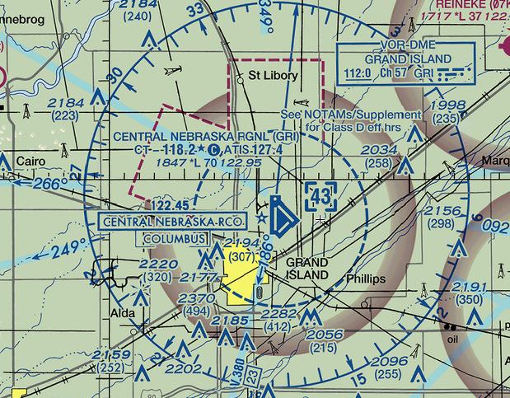
Surface Echo - E4
No ATC authorization needed (Type E4)
Blue dashed line segregates the airspace
ATC authorization needed (Class D)
Extension to Class D airspace
Notes:
Here’s another example of an Echo 4 airspace extension.
Again, the green shaded areas represent the Echo 4 area while the red shaded area in this image signifies a Class Delta airport (meaning it has an operating control tower).
Like the previous example, the key information is the segregating line (this time, a dashed blue line) that segregates Class Delta airspace from the Echo 4 area.
As mentioned in the previous slide, operations in Echo 4 airspace do NOT require an airspace authorization.

Slide 11
Surface Echo - E3
Solid magenta line segregates the airspace
No ATC authorization needed (Type E3)
Extension to Class C airspace
ATC authorization needed (Class C)
Notes:
Here is an example of an Echo 3 extension. Echo 3 extensions are associated with Class Charlie airspace.
Like Echo 4, Echo 3 extensions are segregated from the adjacent airspace. In this case, because the adjacent airspace is Class Charlie, a solid magenta line is used.
And like Echo 4, operations in Echo 3 airspace do NOT require an airspace authorization.

Slide 12
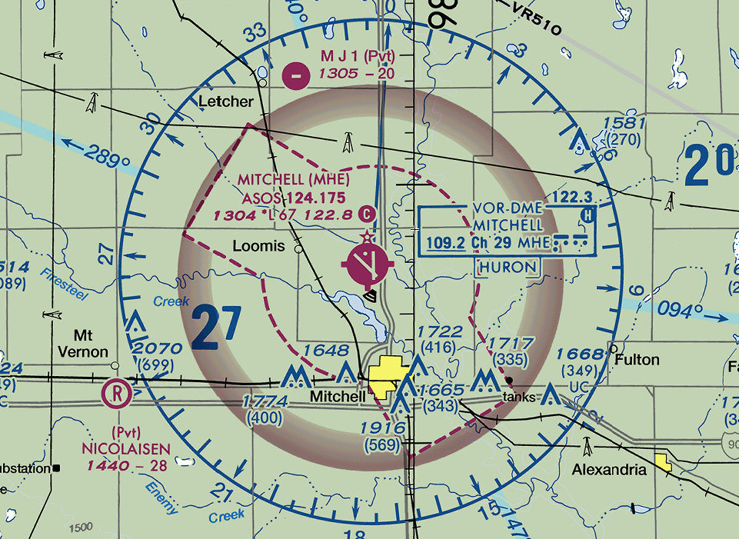
Surface Echo - E2
No dashed line segregating the airspace
ATC authorization needed (Class E2)
Class E2 surface area
Notes:
Sometimes, the extensions are not segregated from the Echo 2 area. In this example, you can see that there are no lines (dashed or solid) segregating the airspace.
In this case, the entire area requires an FAA airspace authorization prior to flight. Echo 2 airspace, including Echo 2 extensions require you obtain an ATC authorization through LAANC or DroneZone before you fly.

Slide 13
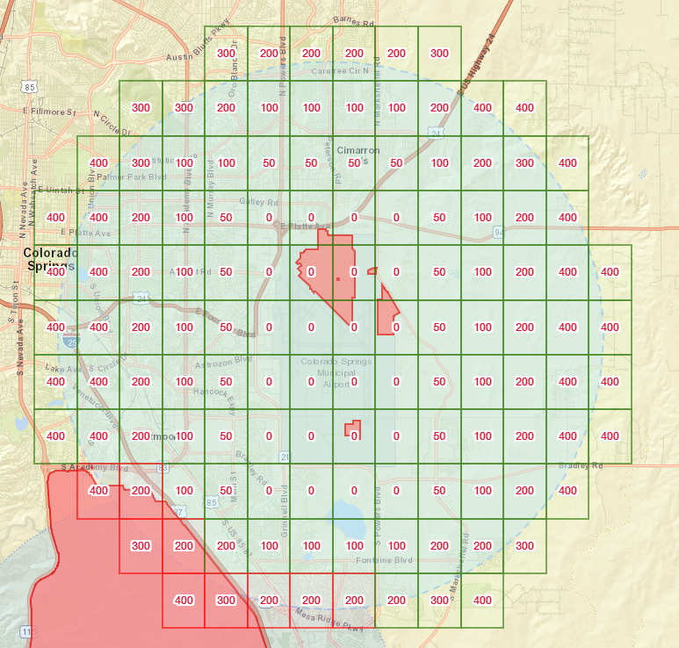
UAS Facility Map:
Identifies areas where ATC authorization is required
Controlled airspace:
Class B
Class C
Class D
Surface Class Echo - E2
Notes:
If you’re new to the drone community and find the FAA aeronautical charts confusing, the UAS Facility Maps can also be a great resource for helping you understand when you would need an airspace authorization.
If the area you would like to operate in requires an airspace authorization, there will be a “grid map” associated with it.
Remember, these are not pre-approved areas. You must receive an airspace authorization prior to operating in any of the Classes of airspace listed here.

Slide 14
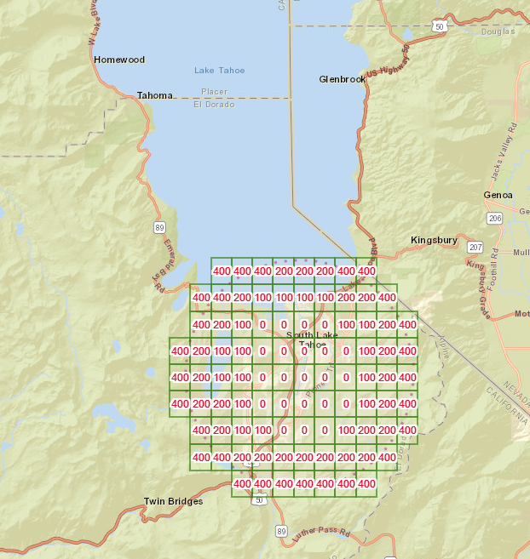
Surface Class E Airspace is segregated
Notes:
To illustrate how the two airspace depictions match up, I’ve placed the aeronautical chart for Lake Tahoe airport next to the UAS Facility Map for the same area.
This example clearly shows that the Echo 2 area (indicated by red shading) has a corresponding “grid map” associated with it, and requires an airspace authorization.
The green shaded area is for the Echo 4 extension. We know it’s Echo 4 airspace because it’s segregated from the Echo 2 airspace.
And as you know, Echo 4 airspace does not require an airspace authorization and therefore does not have a corresponding “grid map” associated with it.

Slide 15
Thank You!
Notes:
Thank you!

