Slide 1
MS-111
sUAS Basic CAP
Training

Slide 2
CAP’s First sUAS Mission
Occurred in April of 2019 as a corporate mission to support the State of Nebraska EMA post flooding.

Slide 3
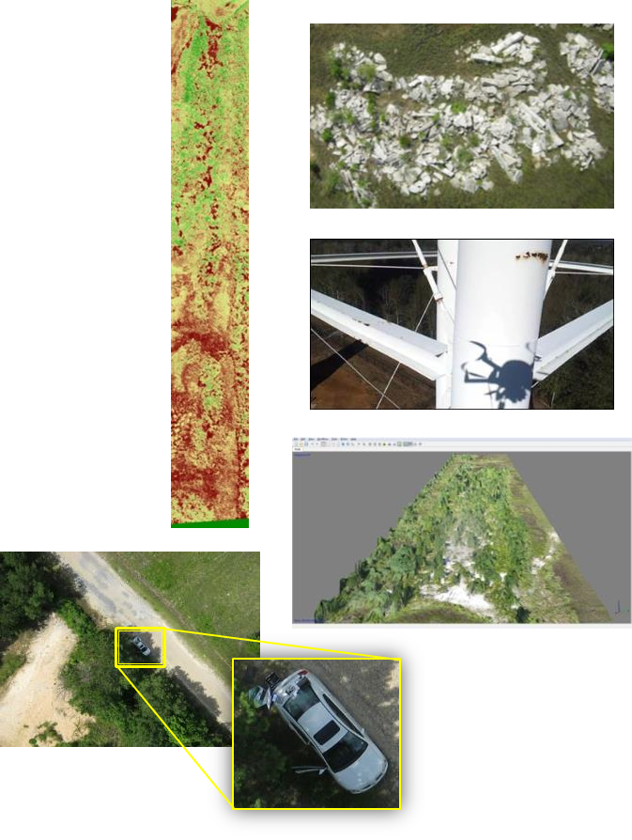
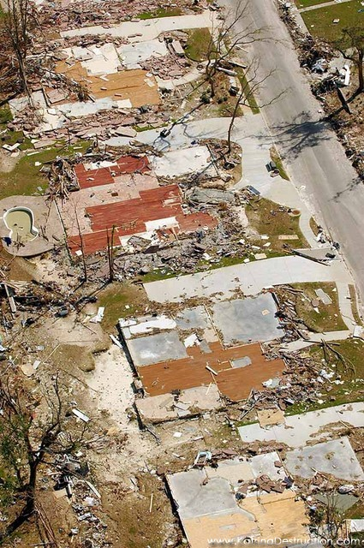
CAP sUAS Missions
Small nimble sUASs with very high resolution imagery allow for the following missions.
Geo-referenced Emergency Response Imagery
Initial assessment of damage
Hi-resolution utilities assessment
Volumetric measurement of piles
Environmental baselines and monitoring
Search and Find
1st mission October 2019 in Indiana
Facility management - critical infrastructure monitoring

Slide 4
Minor Mission sUAS Staffing
sUAS Mission Pilots must hold FAA Part 107 and be qualified as a CAP sUAS Mission Pilot (or be a member in trainee status, supervised by an sUAS Mission Pilot).
The minimum sUAS crew required for flight operations at any site is a pilot and technician.
Technician - an observer who maintains sterile flight area and is ready to take over control is pilot because incapacitated.
Preferably the crew will also have a recorder dedicated to maintaining checklist and flight logs

Slide 5
Major Mission sUAS Staffing
A 22 person sUAS response team is expected to support this level of Defense Support for Civil Authorities (DSCA) regional or national level response.
1 sUAS Team Leader (CAP IC qualified – preferably IC1 or 2)
1 sUAS Safety Officer (CAP MSO qualified)
4 Mission Staff Assistants
8 sUAS Mission Pilots (2 need to be Fixed Wing Qualified)
8 sUAS Technicians

Slide 6
sUAS Packed Push Package
VHF Radio Network
Gas powered Generator
Mobile Office Equipment
Misson Drones*
4 forklift pallets (fit on USAF sized cargo pallet)
Military or civilian shipping

Slide 7
RISK
Standards
Training & Oversight
Basic Civil
Drone Pilot
USAF Standards
Current
FAA Standards
CAPs Current Operations
CAPs Operations Goal

Slide 8
How CAP Mitigates the Risks
Minimum qualification standards and developed regulations
Emphasis on training and repetition is key
Mission planning, approval, and reporting standards
Multiple person flight crews
Chain of Command and required record keeping
Programmed ORM (Operational Risk Management) sUAS Table
Established culture of discipline leads to safety and effectiveness
Support from outside agencies
sUAS don’t connect to the internet during flight
And…

Slide 9
…Discipline
An established culture of discipline leads to safety and effectiveness
Discipline is HARD because we aren’t built for it.
We have to work at being disciplined
Repetition is key
“OCD” is a superpower that can help maintain discipline
Disciplined execution empowers the crew

Slide 10
Safety Underpins Everything We Do
“UAS are Toys” indicates lack of appreciation of the responsibilities inherent in aviation.
These sUASs are a privilege we have because other squadrons have not had major safety issues. We will keep it that way.
If you see what you think could be an unsafe situation SPEAK UP!
Safety is everyones responsibility and duty to each other.

Slide 11
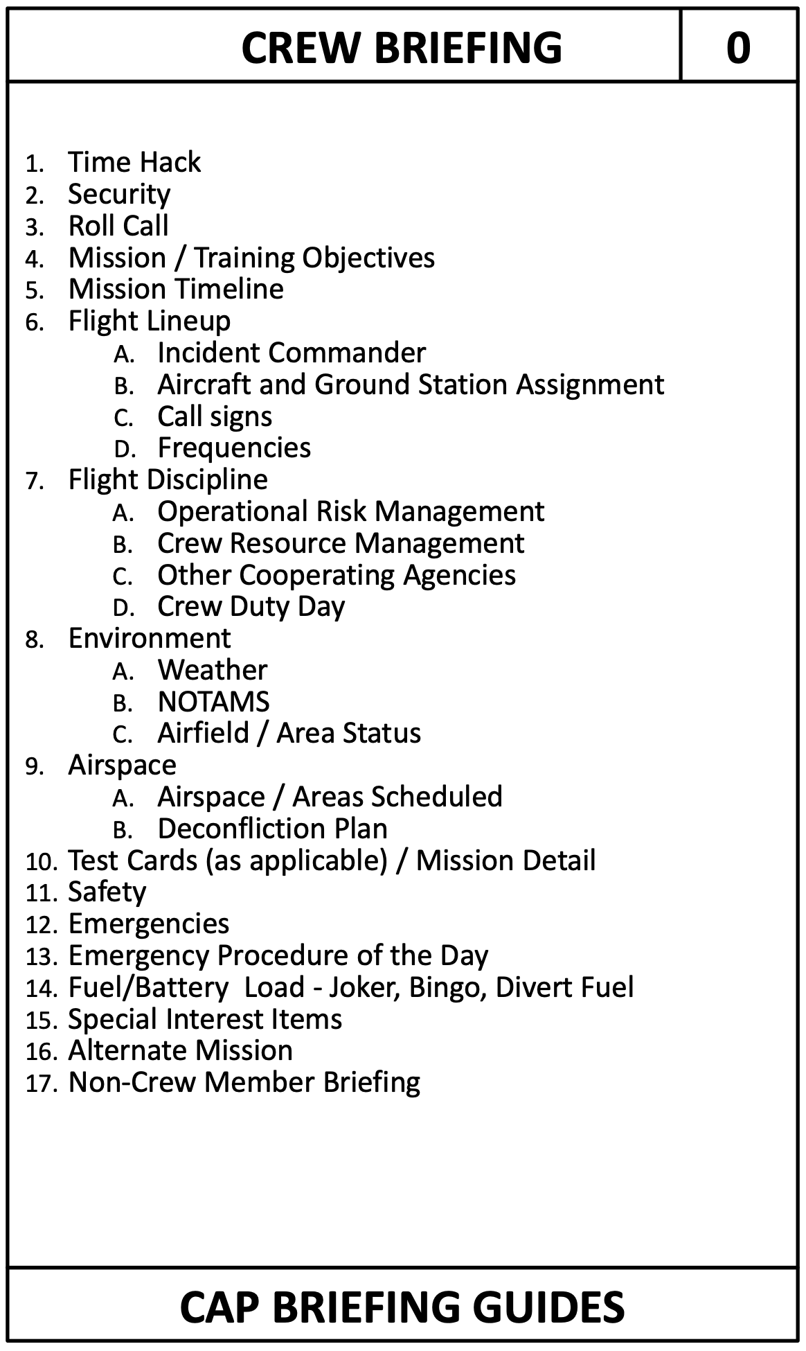
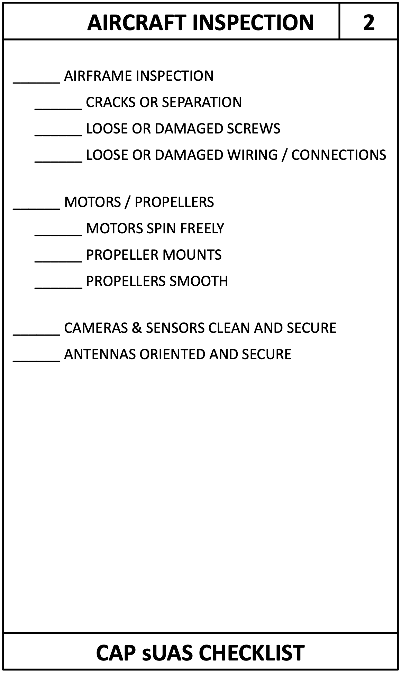
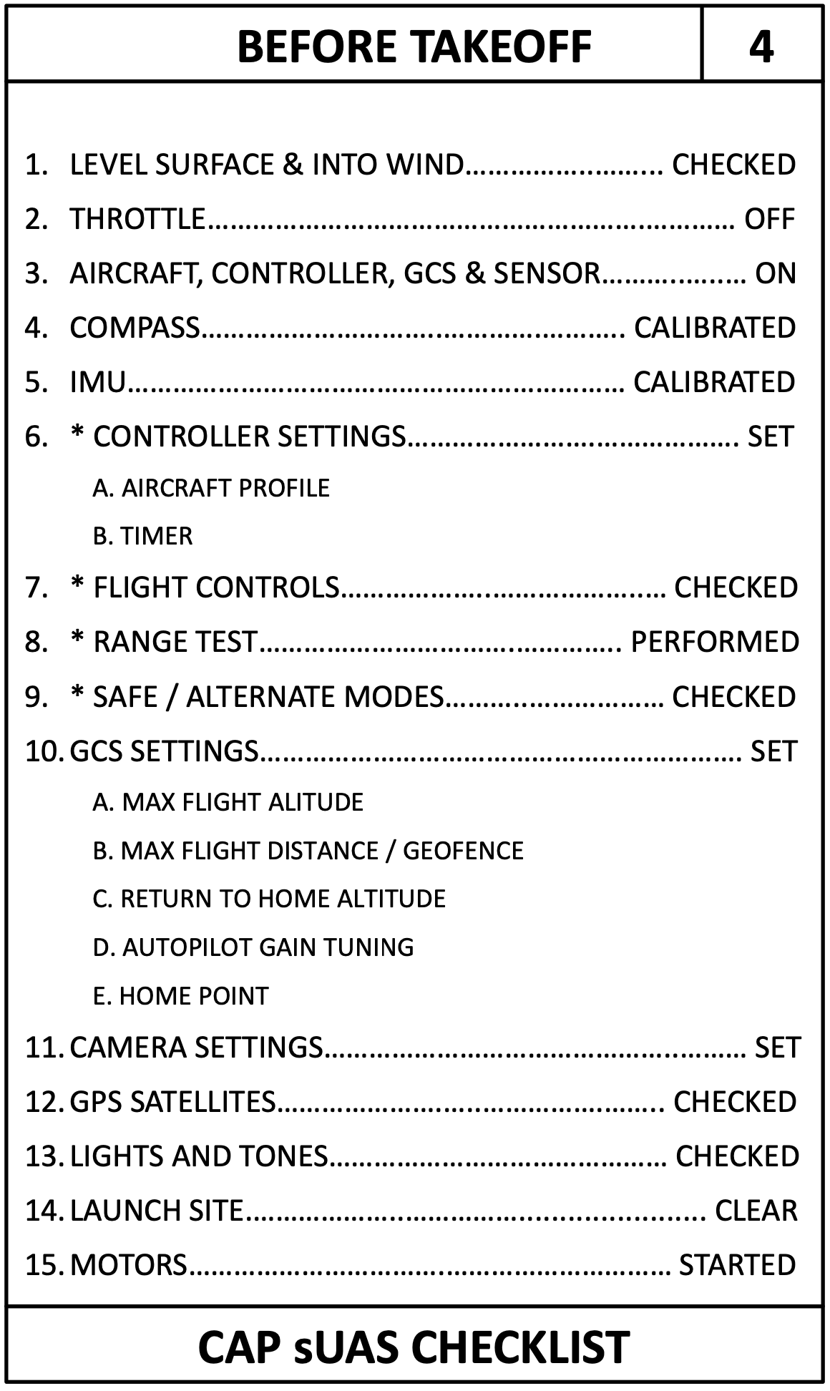
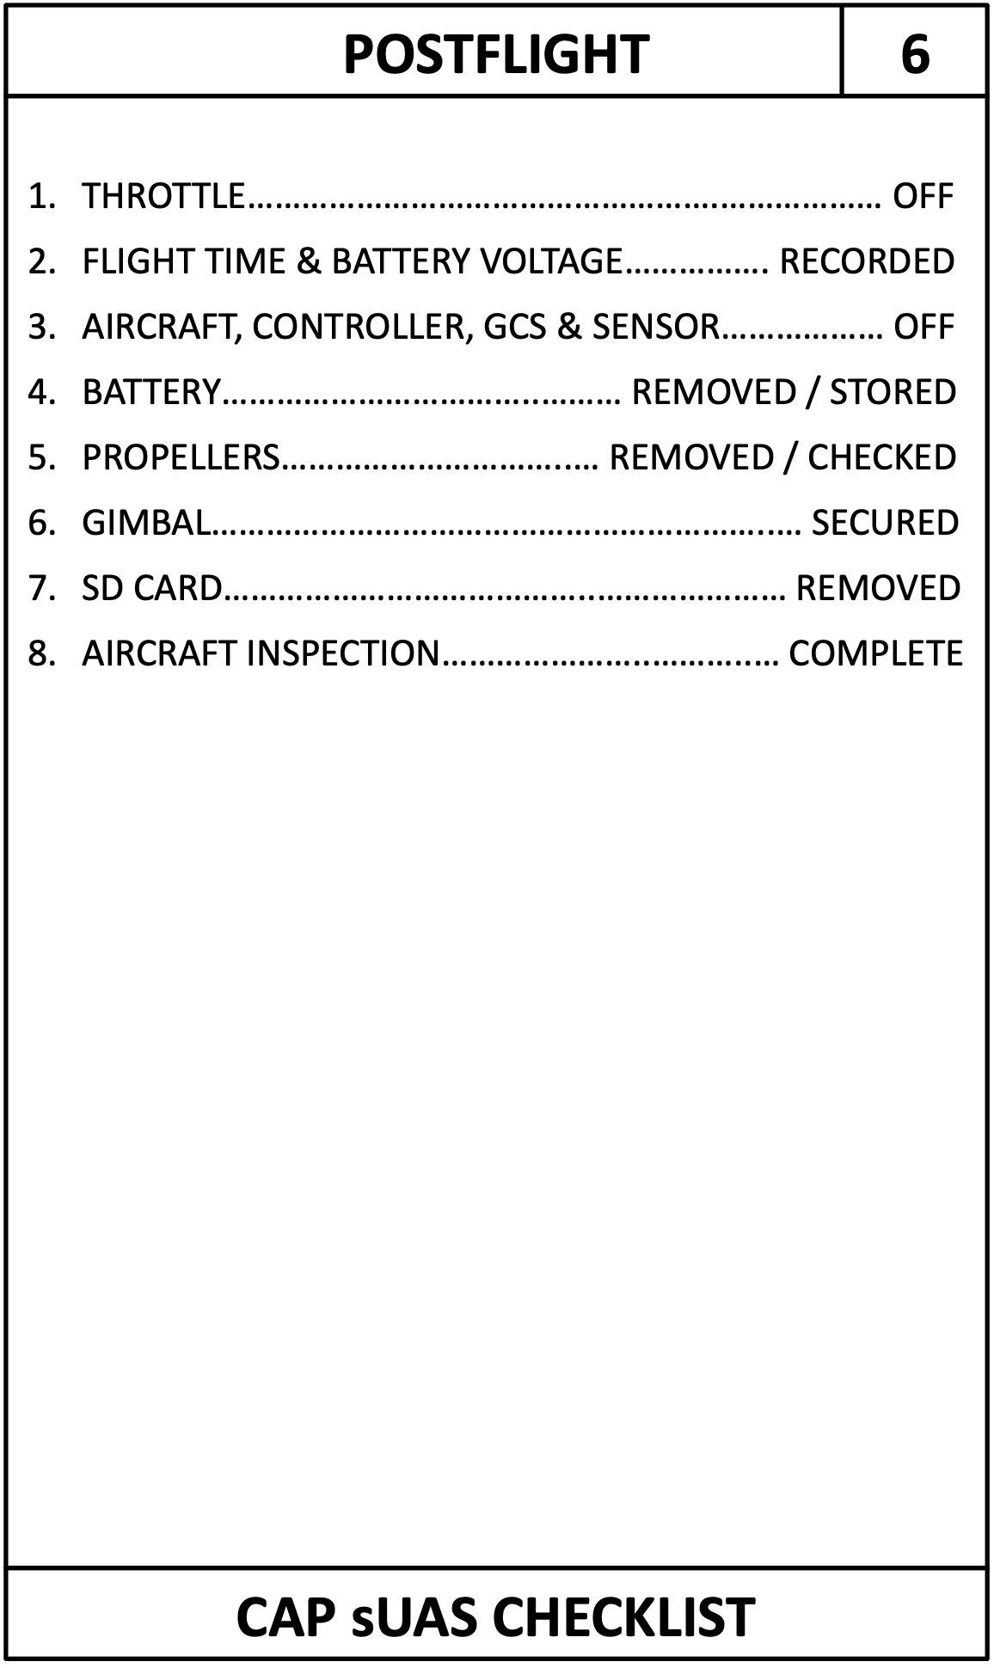
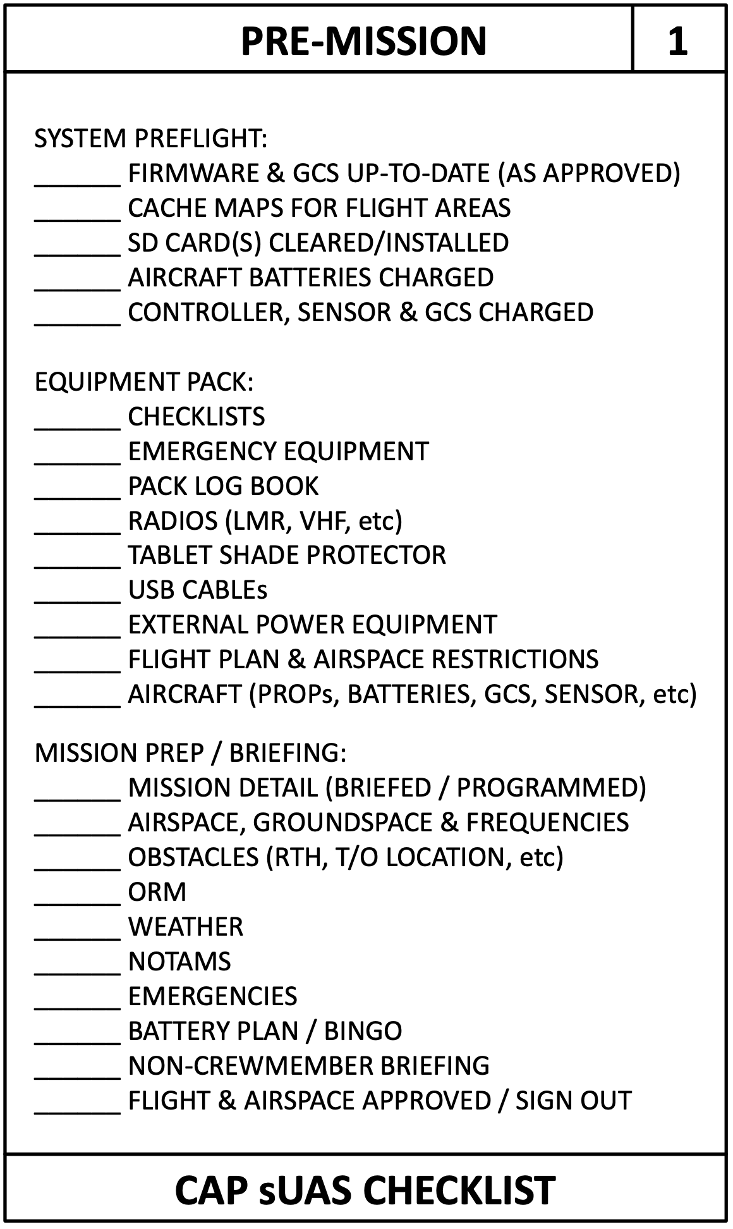
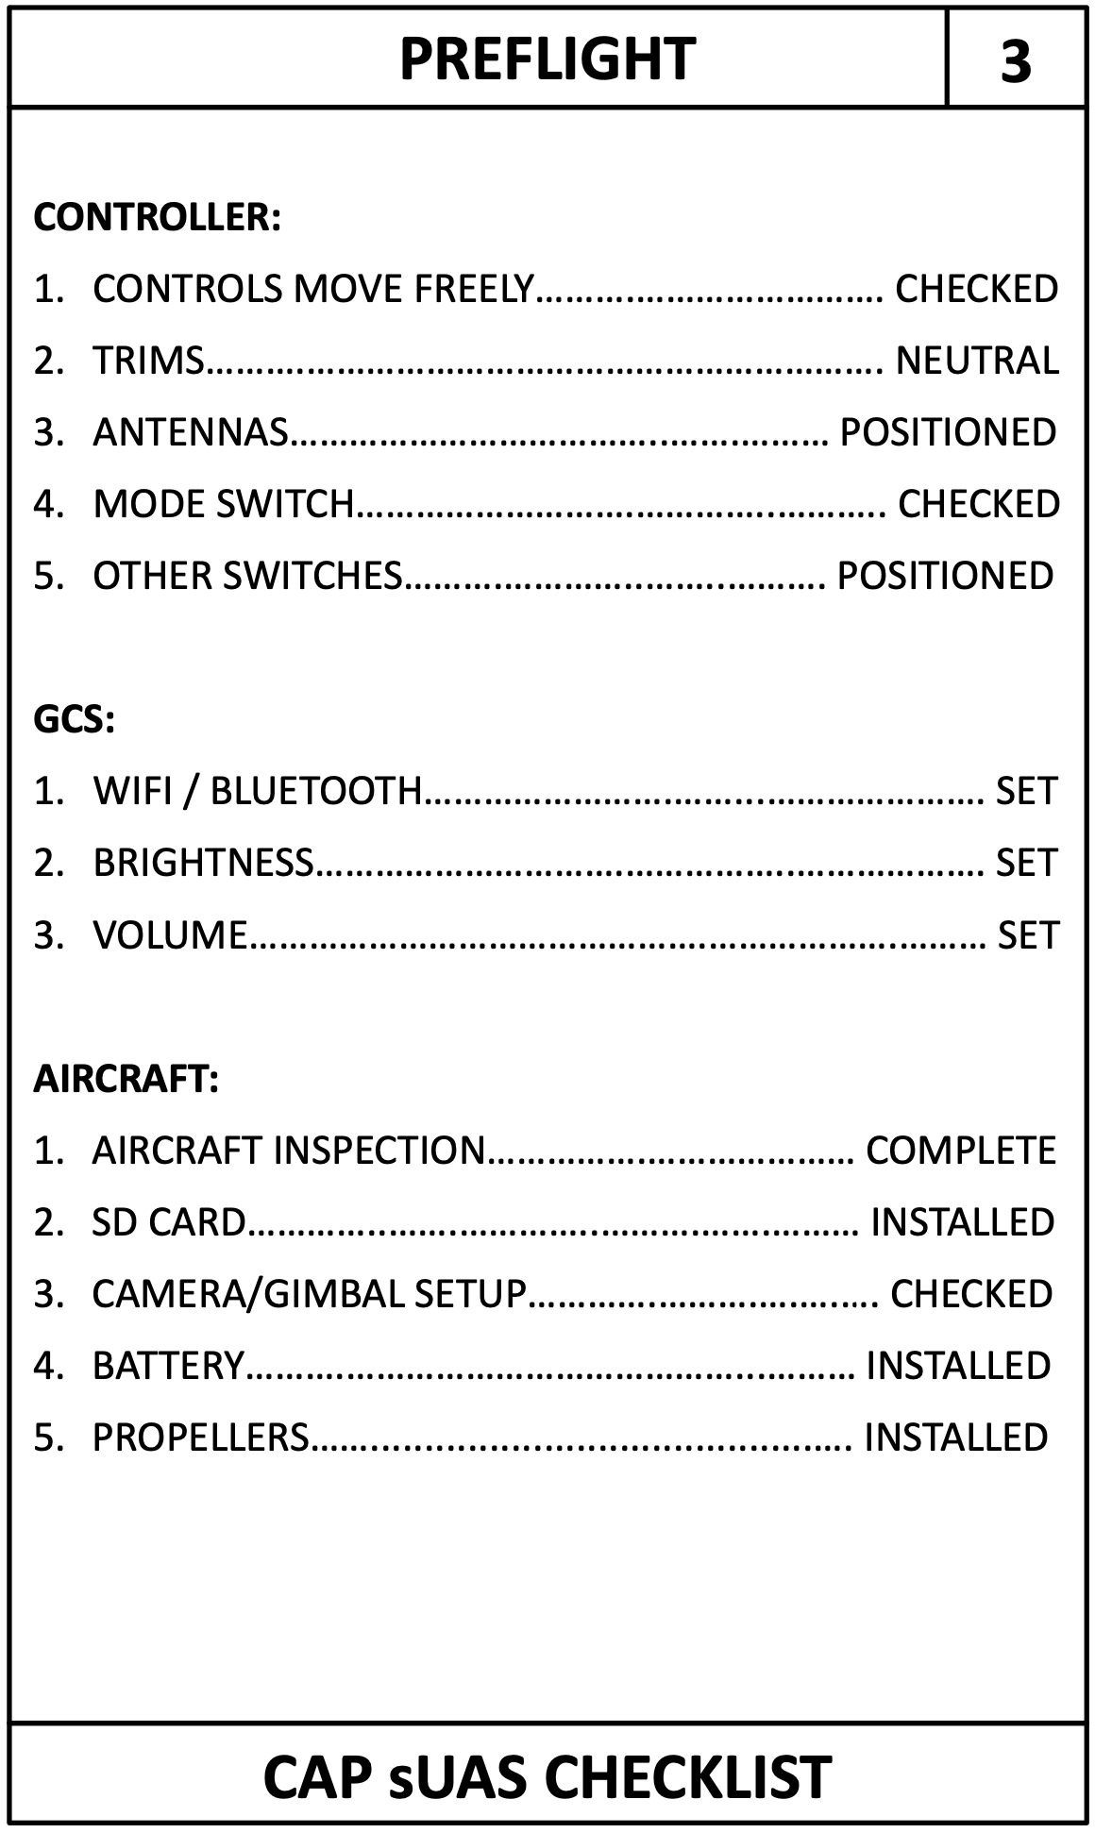
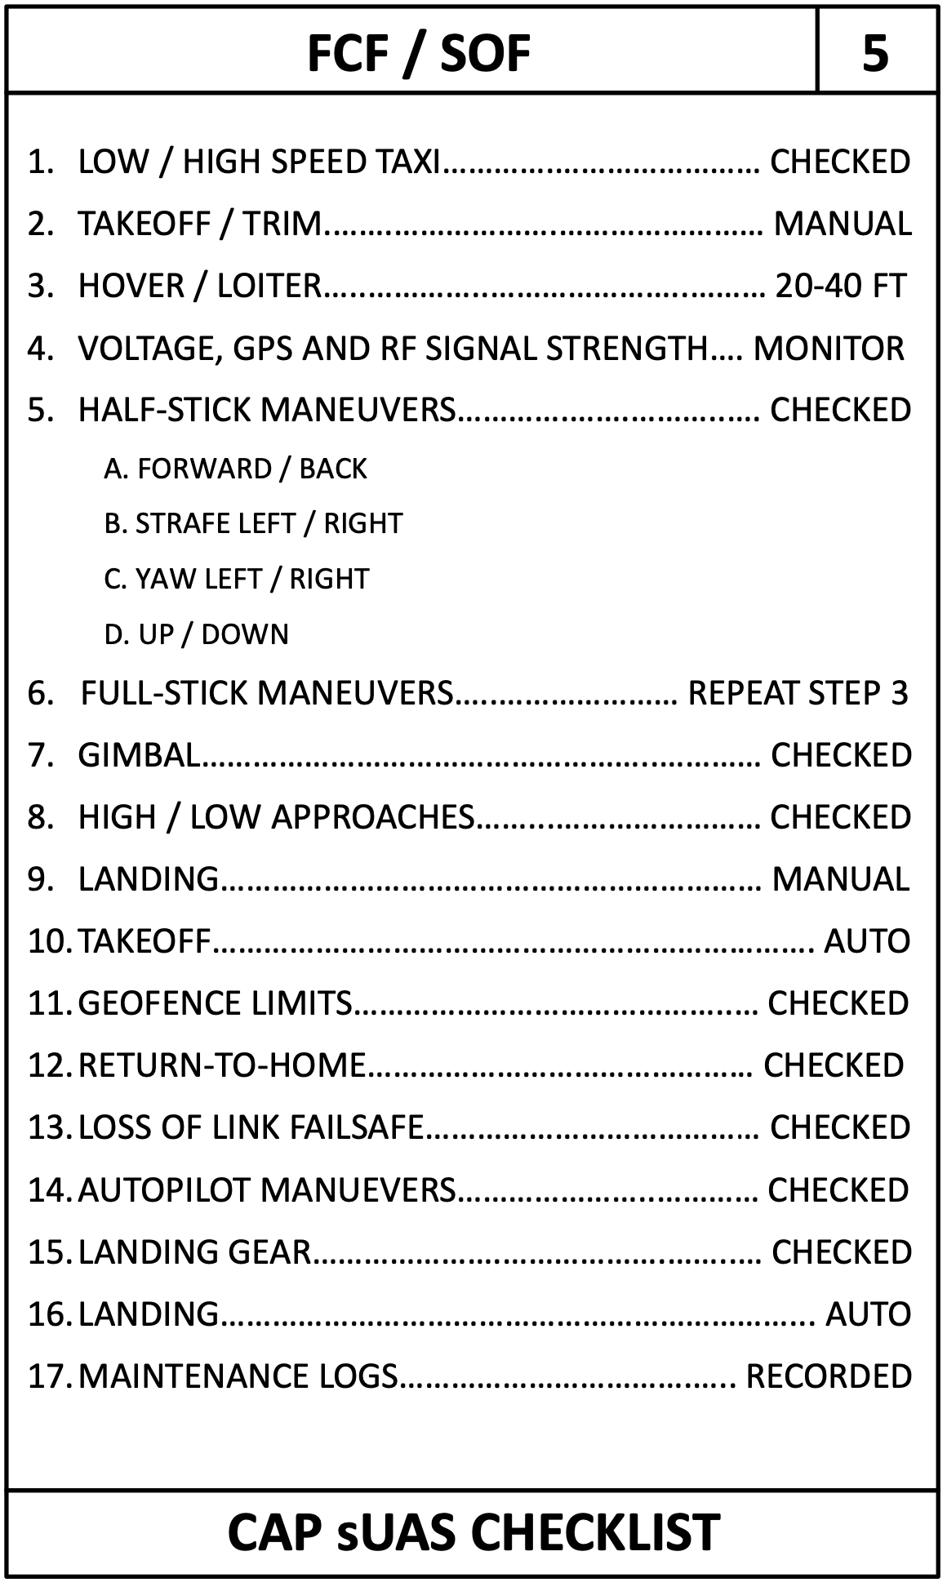
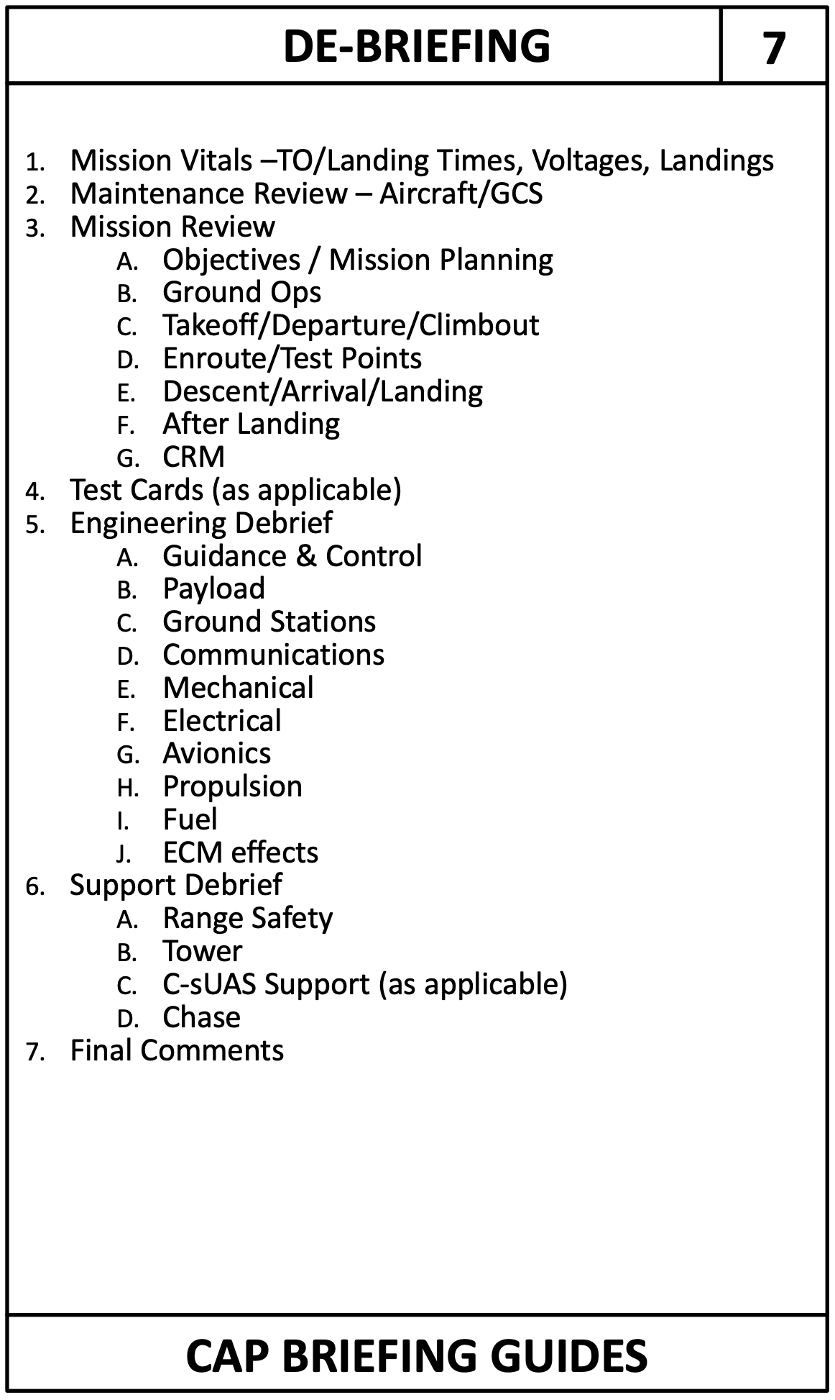

Slide 12
Flying and Mini Training Drills
Maintain altitude during drills
Do not go beyond the area of the drill
Minimize landing in grass/dirt - Use LZ (landing zone) pad
Drills are meant for slow deliberate flight, not aggressive; stay in control
Repeat the drills until you are consistent
They will seem repetitive but they are teaching your brain how to control your fingers without you thinking about your fingers

Slide 13
TRUST Rules - USC 44809
Fly only for recreational purposes
Follow the safety guidelines of an FAA-recognized Community Based Organization or for now AC 91.5B ex) https://www.flitetest.com/pages/safetyguidelines
Keep your drove within visual line of sight or use a visual observer
Give way to and do not interfere with manned aircraft
Get LAANC of DroneZone airspace approval to fly in not in Class G (uncontrolled) airspace
Fly at or below 400’ (or controlled airspace approved height)
Take TRUST (it is a FREE course and not a test) and carry proof you passed test Multiple website offer the course
Have current registration if your drone is over 250 gram mark it on outside of drone, carry proof of registration
Do not operate your drone in a dangerous manner. - Interfering with emergency response - Operating from a moving vehicle* or aircraft - Do not carry hazardous materials - Fly without doing a preflight inspection - While under the influence - Do not fly over people on in restricted airspace.

Slide 14
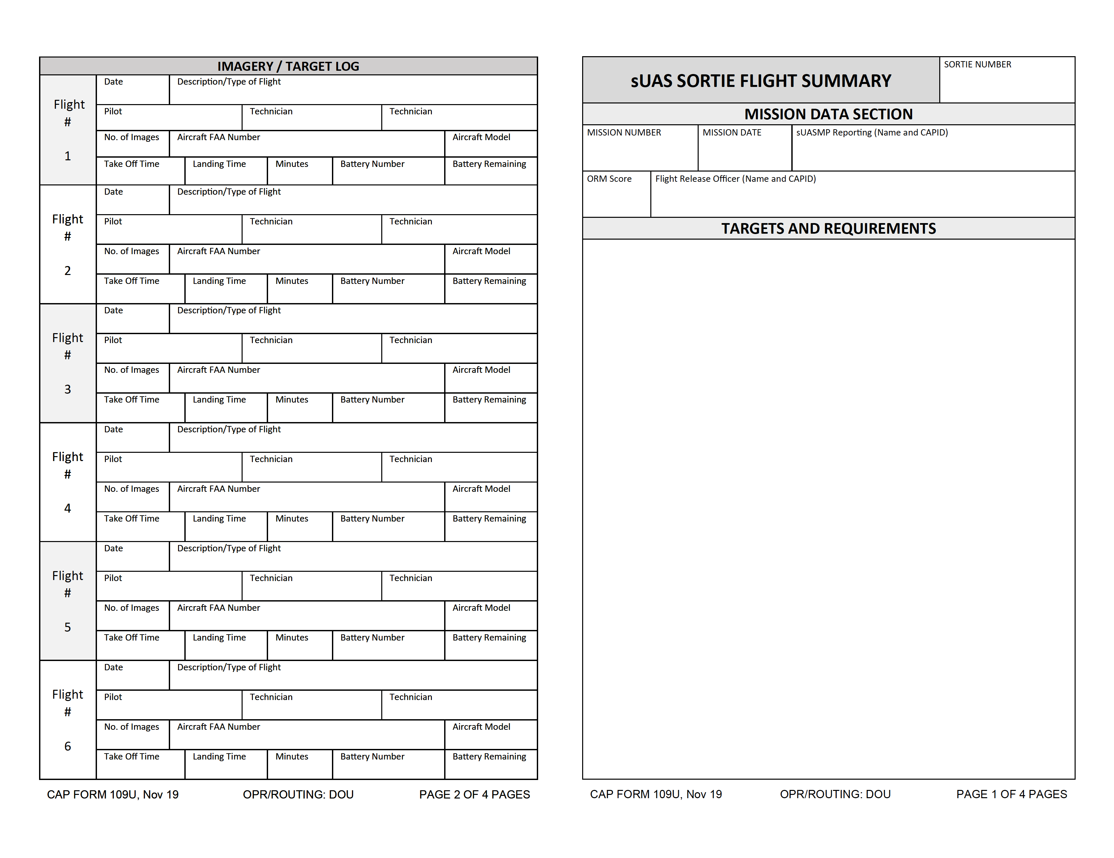
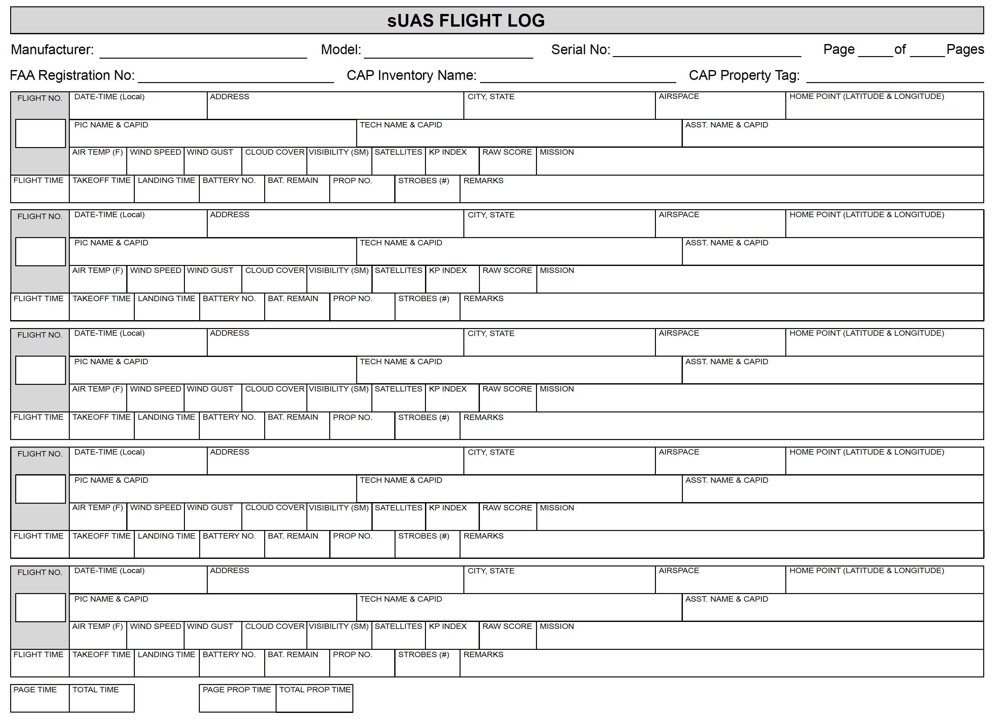
Two CAP Log Requirements

